Slide 1
Attention is All You Need

Slide 2
Outline
Overview of architecture
History regarding Attention is All You Need.
Use Cases
Why learn the building blocks?
What does MLP, Linear & soft max mean?
What is positional & semantic embedding?
What is a residual connection?
What is layer normalization?
What is attention?
End

Slide 3
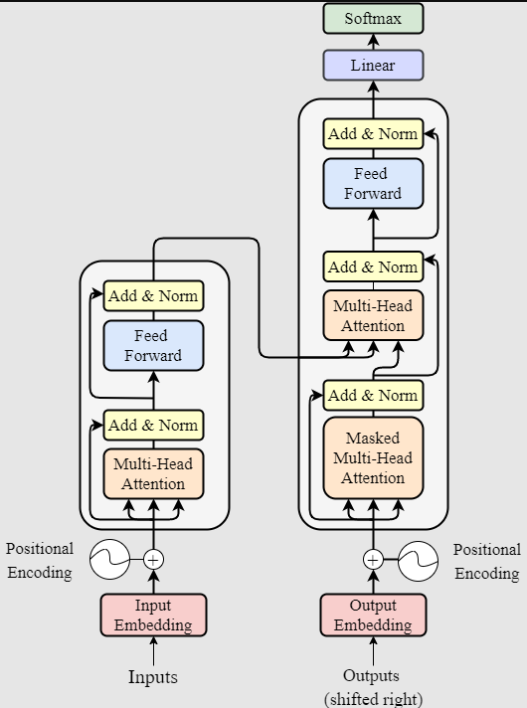
The architecture
There are several repeated building blocks to transformers. They are..
Attention layer
Residual layer
Layer normalization
Feed forward
Positional Encoder
Semantic Encoder
The decoder and encoder are essentially the same as you can see on the right. The difference-encoders behave as an input to another part of the architecture.
We can use encoders and decoders on their own. No problem.

Slide 4
The history
As said in the abstract-attention, decoders and encoders already existed by 2017. These 3 were repurposed for language processing.
RNNs used attention, decoders & encoders
CNNs used attention, decoders & encoders
There were many hybrids and architectures being developed in 2017
Attention is All You Need brought an architecture primarily using attention to the forefront rather than recurrence (RNN) or convolution (CNN).
Since its inception Transformers have taken over sequence to sequence machine learning due to…
Parallelization
Parameter utilization (Increasing parameters actually makes a difference)
Low shot requirement (Works well on unseen data)
Versatility across input to output types (modals)

Slide 5
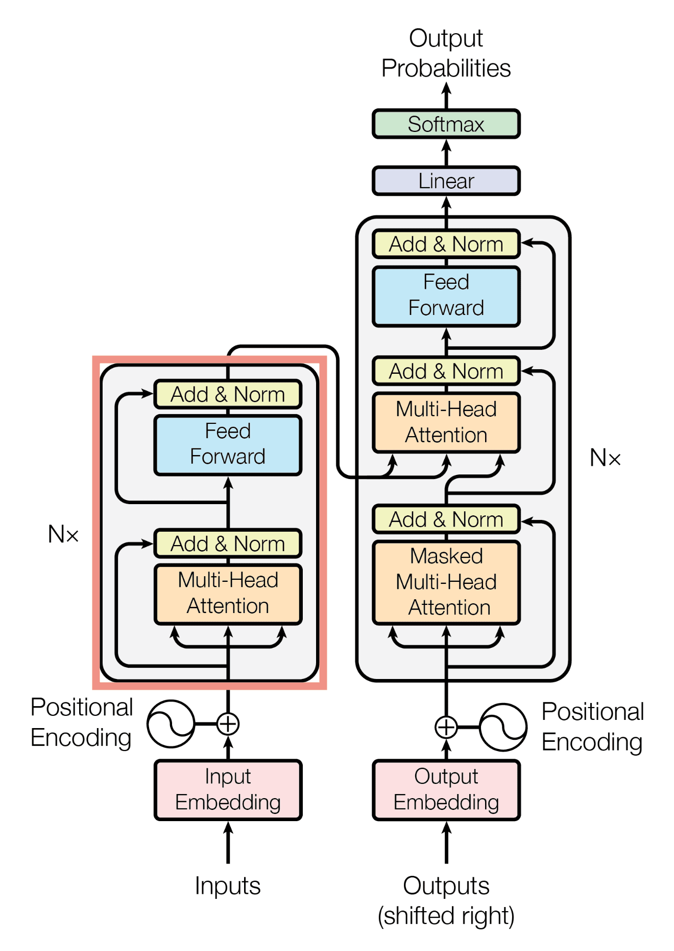
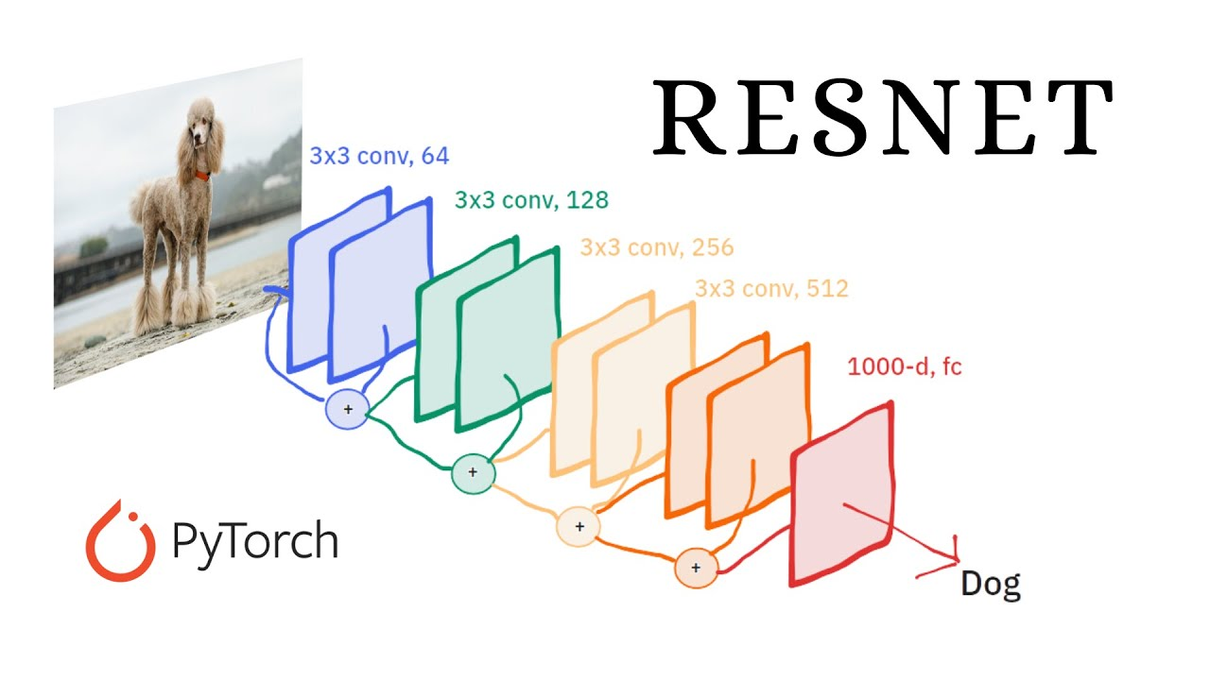
Use cases
Transformers learn best from sequential problems.
They learn NLP faster and with less training
They require more data from static modals like vision or coordinate based than would more specialized architectures.
Vision transformers separate the data into consumable sequences for transformers. (A different architecture than top left)
Vision transformers require more data than CNN. CNN will train faster.
VS

Slide 6
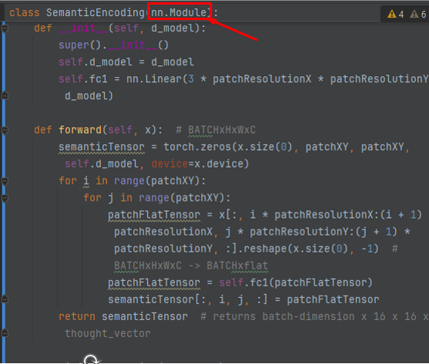
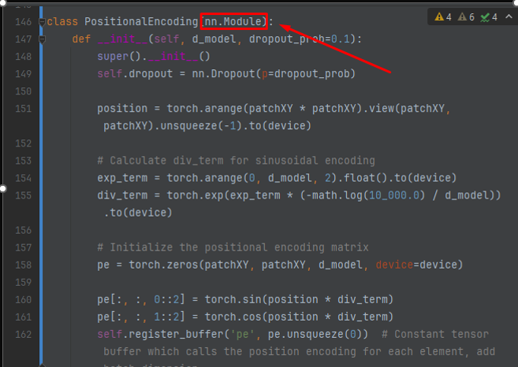
Why learn Modules AKA building blocks?
Any child class of modules are small containers of tensor change.
Input tensor -> Module -> new tensor
In PyTorch these building blocks are, denoted by the nn.Module abstract class.
In the context of data we use these modules to piece together new or old architectures like the one here in Attention is All You Need.
Our goal is to pick up on these layers / blocks from each paper so we can use them on tensors created from data.

Slide 7
Input & Output (ignoring batch sizing)
The input to the transformer is a 1D tensor of word tokens. This makes the length of the tensor the sequence length. For example, “Vegetables are healthy” would be [“vegetables”, “are”, “healthy”] or the tensor [55, 800, 12]. We then input these numbers into the transformer.
The output is a Sequence length X Vocabulary Probability. So lets say we have a sequence length of 3 like above but a total vocabulary of 10,000. This would make the tensor:
[
[1, 2, 3, 4, 5… 9999, 10,000]
[1, 2, 3, 4, 5… 9999, 10,000]
[1, 2, 3, 4, 5… 9999, 10,000]
]
Each 1 to 10,000 is the probability of one word.
*There are actually two inputs,
one for each language

Slide 8
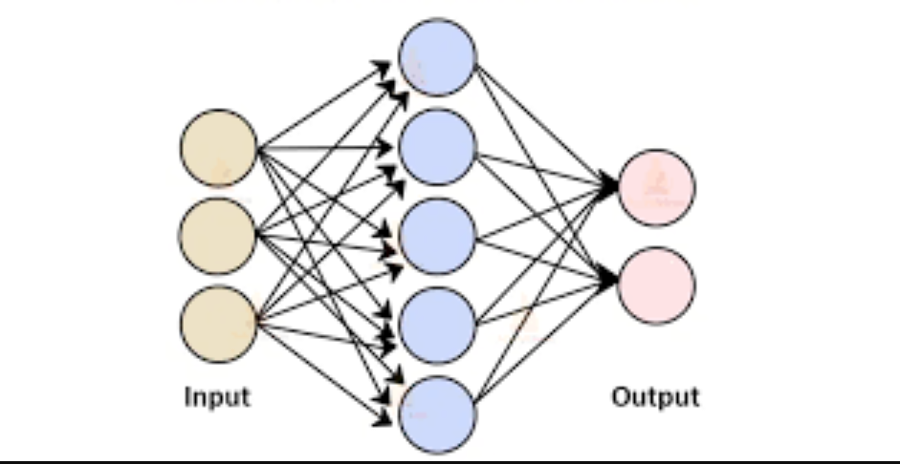
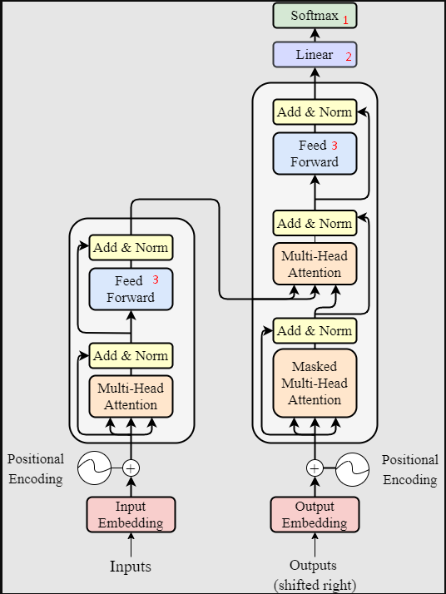
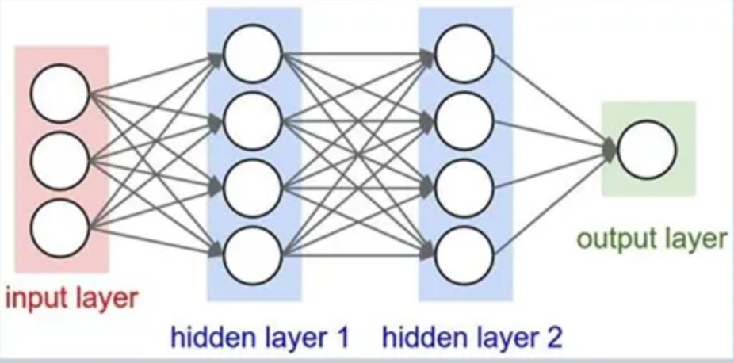
Building block: MLP, Linear, feed forward & soft max
1. Softmax is an activation function which makes the entire output tensor sum up to one. We then choose the value in the tensor with the highest number. This is how we choose words at the output.
2. A linear layer is a neural network with 1 layer. This layer is called linear because the weights and biases look like the typical Y = m*X + b.
3. Feed forward AKA Multilayer Perceptron is a neural network with two or more layers. Perceptron means neural network and multilayer means 2 or more. Feed forward is the same as MLP
Linear
Multilayer

Slide 9
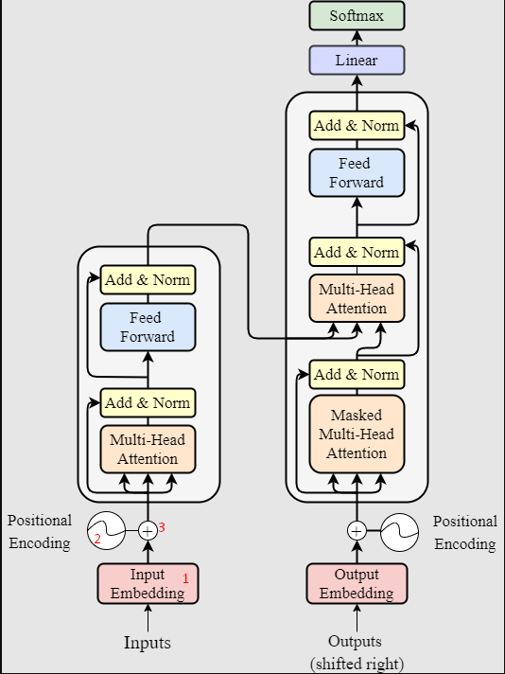
Building block: semantic & positional embedding?
1. Input embedding converts input tokens like [“vegetables”, “are”, “healthy”] or the tensor [55, 800, 12] into a “thought vector”. A sequence of numbers representing the semantic meaning of each word. So we represent the dictionary meaning as a list of numbers.
2. We use an algorithm to give a certain value per position in the sequence. Each index of the sequence has a specific value like 1, 2, 3, 4, 5. Instead of individual indexes though we use a cosine wave which is what that circle is in the picture.
3. We then add them together as one overall thought vector with position and dictionary meaning…

Slide 10
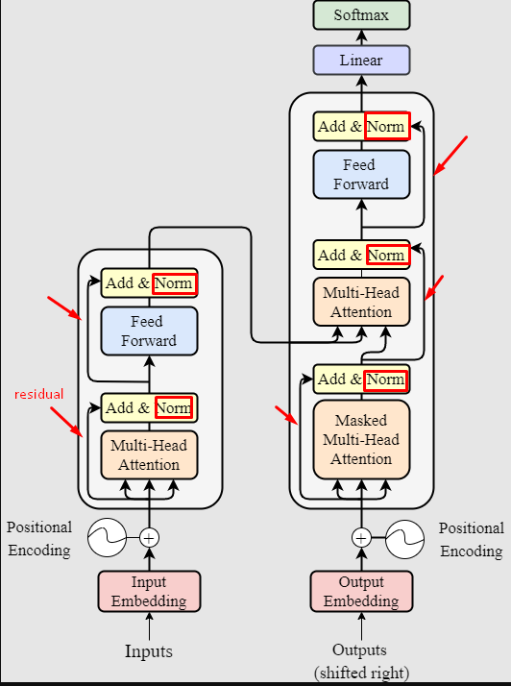
Building block: residual connections & layer norms
Normalization or norm converts a vector to a mean of 0 and a standard deviation of 1. This allows the tensors to flow without getting too large or too small.
A residual connection is saving a value for future use. We just add these previous tensors to a future layer

Slide 11
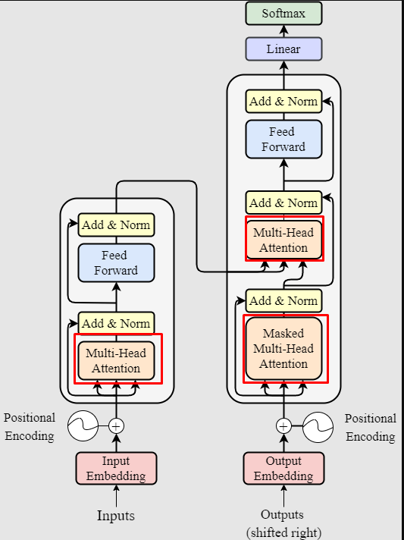
Building block: Attention
The sum of attention in this paper is…
Positional + Dictionary = Context Aware
We take a Query, Key Value of the same tensor, the position + dictionary, then combine them in back propagation as a unique “Thought vector” that understands that specific meaning of the sentence.
The output of an attention block is Sequence Length X Embedding AKA Thought/Context vector.
This means if you change one word in the entire sequence, that output of the attention will change. This is because we give attention to the entire sequence for our thought vector.

Slide 12
End
Hopefully most of this is correct. As this my understanding is from my research paper reading and previous classes.
Attention: https://youtu.be/eMlx5fFNoYc?si=7teH4esUcFTEa6W3
Positional Encoding: https://youtu.be/T3OT8kqoqjc?si=qwSvYR1_c1Yum7_e

